Slide 1
Clustering Algorithms

Slide 2
What is Clustering ?
Clustering is a process of partitioning a set of data (or objects) into a set of meaningful sub-classes, called clusters.
Helps users understand the natural grouping or structure in a data set
Cluster: a group of objects are clustered because they are “similar”.
Clustering : unsupervised learning, no predefined classes.

Slide 3
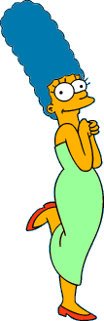







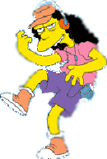


Two Types of Clustering
Partitional algorithms: Construct various partitions and then evaluate them by some criterion
Hierarchical algorithms: Create a hierarchical decomposition of the set of objects using some criterion
Hierarchical
Partitional

Slide 4
Clustering Algorithms
Partitioning Methods
k-means and k-medoids algorithms and their refinements
Hierarchical Methods
Agglomerative and divisive method, Birch, CURE, Cameleon
Density-Based Methods
DBScan, Optics and DenCLu
Grid-Based Methods
STING and CLIQUE (subspace clustering)

Slide 5
K-means Algorithms
Works with numeric data only
Pick a number (K) of cluster centers (at random)
Assign every item to its nearest cluster center (e.g. using Euclidean distance)
Move each cluster center to the mean of its assigned items
Repeat steps 2,3 until convergence (change in cluster assignments less than a threshold)

Slide 6
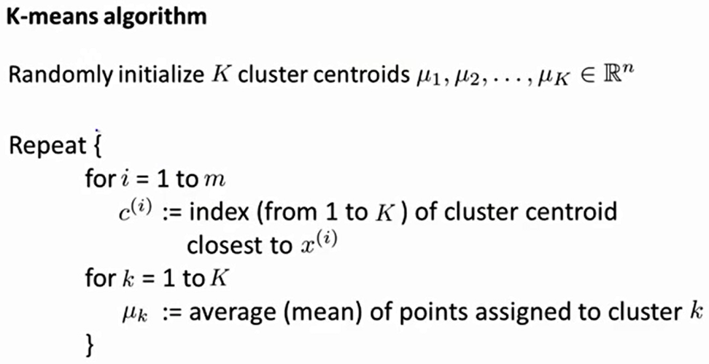
K-means Algorithms

Slide 7
K-means example, step 1
k₁
Y
Pick 3
initial
cluster
centers
(randomly)
k₂
k₃
X

Slide 8
K-means example, step 2
k₁
Y
k₂
Assign
each point
to the closest
cluster
center
k₃
X

Slide 9
K-means example, step 3
k₁
k₁
Y
Move
each cluster center
to the mean
of each cluster
k₂
k₃
k₂
k₃
X

Slide 10
K-means example, step 4
Reassign
points
closest to a different new cluster center
Q: Which points are reassigned?
k₁
Y
k₃
k₂
X

Slide 11
K-means example, step 4 …
k₁
Y
A: three points with animation
k₃
k₂
X

Slide 12
K-means example, step 4b
k₁
Y
re-compute cluster means
k₃
k₂
X

Slide 13
K-means example, step 5
k₁
Y
k₂
move cluster centers to cluster means
k₃
X

Slide 14
Discussion: Randomly Initialization K Cluster Centroids
Result can vary significantly depending on initial choice of seeds (number and position)
Can get trapped in local minimum
Example:
Q: What can be done?
A: To increase chance of finding global optimum: restart with different random seeds.
Optimal Clustering
Sub-optimal Clustering

Slide 15
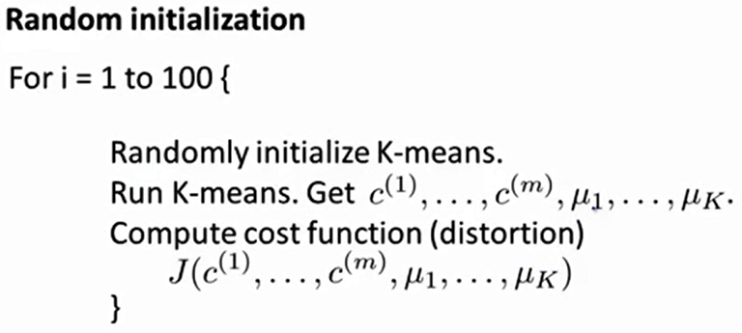
Discussion: Randomly Initialization K Cluster Centroids

Slide 16
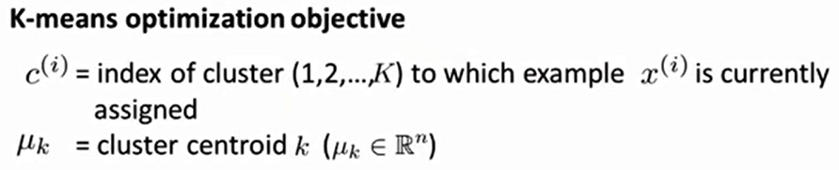
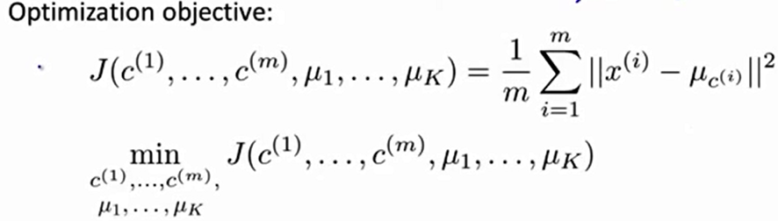
Discussion: Randomly Initialization K Cluster Centroids

Slide 17
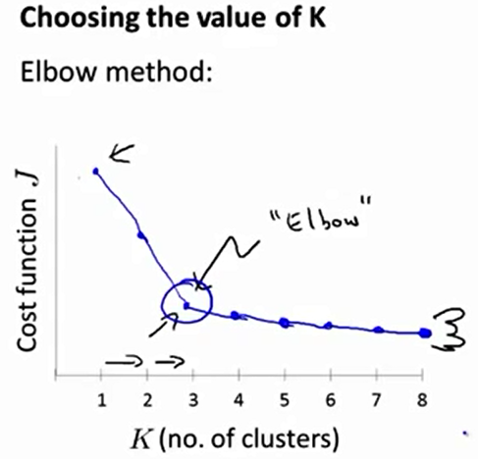
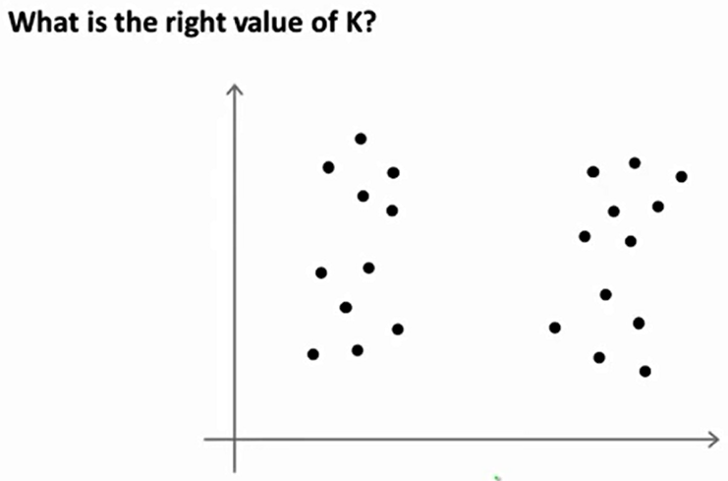
Discussion: Choosing the number of clusters

Slide 18
K-means clustering
Advantages
Simple, understandable
items automatically assigned to clusters
Disadvantages
Must pick number of clusters before hand
All items forced into a cluster
Too sensitive to outliers

Slide 19
Limitations of K-means
K-means has problems when clusters are of differing
Sizes
Densities
Non-globular shapes
K-means has problems when the data contains outliers.
The number of clusters (K) is difficult to determine.

Slide 20
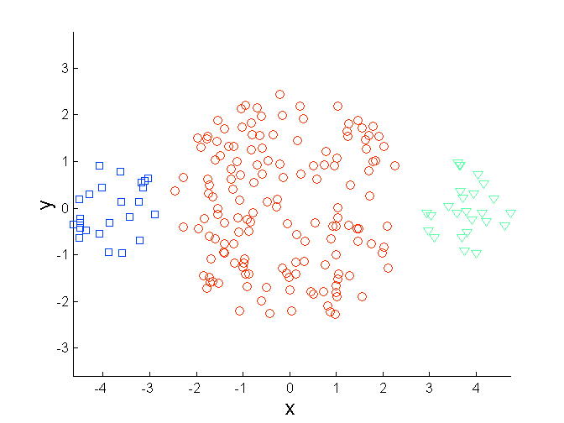
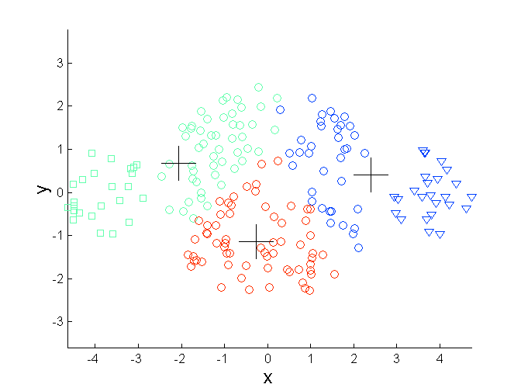
Limitations of K-means: Differing Sizes
Original Points
K-means (3 Clusters)

Slide 21
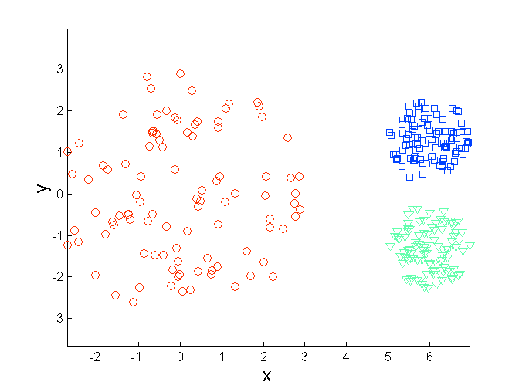
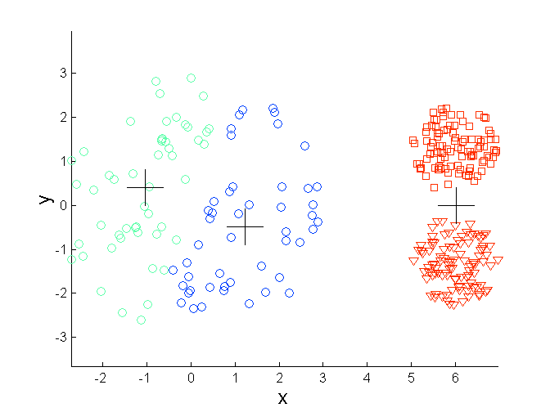
Limitations of K-means: Differing Density
Original Points
K-means (3 Clusters)

Slide 22
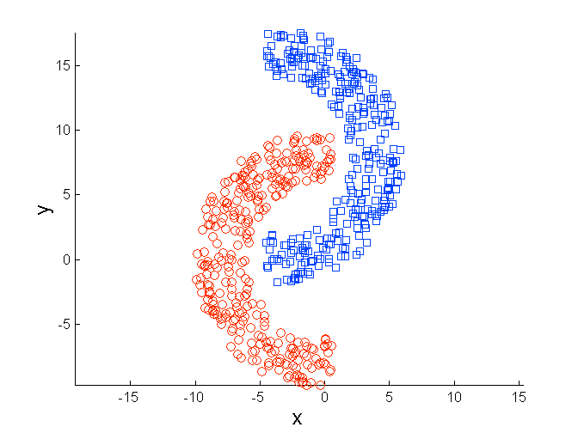
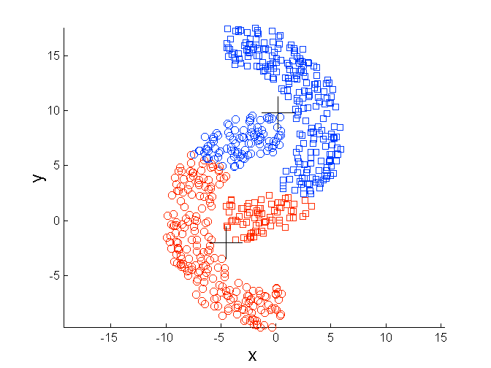
Limitations of K-means: Non-globular Shapes
Original Points
K-means (2 Clusters)

Slide 23
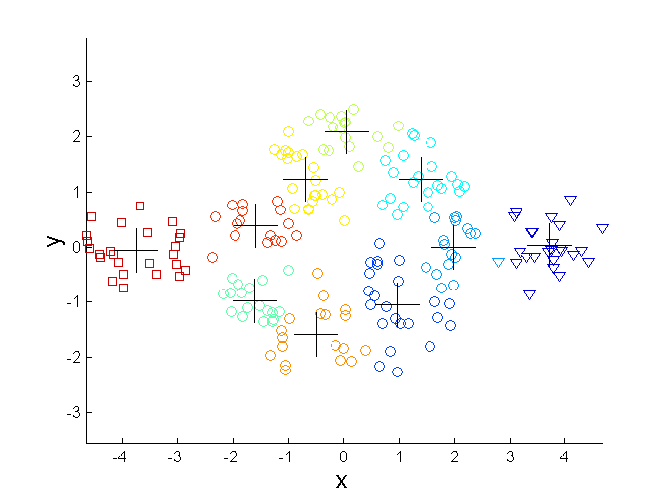
Overcoming K-means Limitations
Original Points K-means Clusters
One solution is to use many clusters.
Find parts of clusters, but need to put together.

Slide 24
K-means variations
What can be done about outliers?
K-medoids – instead of mean, use medians of each cluster
Mean of 1, 3, 5, 7, 9 is
Mean of 1, 3, 5, 7, 1009 is
Median of 1, 3, 5, 7, 1009 is
Median advantage: not affected by extreme values
For large databases, use sampling
5
205
5

Slide 25
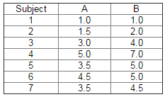
Example: K-Means Algorithm
This data set is to be grouped into two clusters.

Slide 26

Example for K-Means
Step 1 : Pick a number (K) of cluster centers Finding a sensible initial partition, let the A & B values of the two individuals furthest apart (using the Euclidean distance

Slide 27
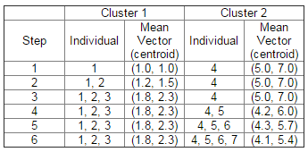

Example for K-Means
Step 2: Assign every item to its nearest cluster center
Step 3: Move each cluster center to the mean of its assigned items

Slide 28
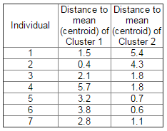

Example for K-Means
Step 4: Repeat steps 2,3 until convergence (change in cluster assignments less than a threshold)

Slide 29
Hierarchical Clustering
Produces a set of nested clusters organized as a hierarchical tree
Can be visualized as a dendrogram
A tree like diagram that records the sequences of merges or splits

Slide 30
Hierarchical Clustering
Two main types of hierarchical clustering
Agglomerative:
Start with the points as individual clusters
At each step, merge the closest pair of clusters until only one cluster (or k clusters) left
Divisive:
Start with one, all-inclusive cluster
At each step, split a cluster until each cluster contains a point (or there are k clusters)
Traditional hierarchical algorithms use a similarity or distance matrix
Merge or split one cluster at a time

Slide 31
Agglomerative Clustering Algorithm
More popular hierarchical clustering technique
Basic algorithm is straightforward
Compute the proximity matrix
Let each data point be a cluster
Repeat
Merge the two closest clusters
Update the proximity matrix
Until only a single cluster remains
Key operation is the computation of the proximity of two clusters
Different approaches to defining the distance between clusters distinguish the different algorithms

Slide 32


We begin with a distance matrix which contains the distances between every pair of objects in dataset
0
8
8
7
7
0
2
4
4
D( , ) = 8
D( , ) = 1
0
3
3
0
1
0

Slide 33
Bottom-Up (agglomerative): Starting with each item in its own cluster, find the best pair to merge into a new cluster. Repeat until all clusters are fused together.
Consider all possible merges…
Choose the best
…

Slide 34
Bottom-Up (agglomerative): Starting with each item in its own cluster, find the best pair to merge into a new cluster. Repeat until all clusters are fused together.
Consider all possible merges…
Choose the best
…
Consider all possible merges…
Choose the best
…

Slide 35
Bottom-Up (agglomerative): Starting with each item in its own cluster, find the best pair to merge into a new cluster. Repeat until all clusters are fused together.
Consider all possible merges…
Choose the best
…
Consider all possible merges…
Choose the best
…
Consider all possible merges…
Choose the best
…

Slide 36
Bottom-Up (agglomerative): Starting with each item in its own cluster, find the best pair to merge into a new cluster. Repeat until all clusters are fused together.
Consider all possible merges…
Choose the best
…
Consider all possible merges…
Choose the best
…
Consider all possible merges…
Choose the best
…

Slide 37


0
8
8
?
0
8
8
7
7
0
2
?
0
2
4
4
0
8
8
0
?
0
3
3
0
2
?
0
1
0
But what values do we fill in?
What is…
0
In the first iteration of agglomerative clustering we merged so we need to remove them from the matrix
We now need to add the single cluster to our new smaller matrix
D( , ) = ?
D( , ) = ?

Slide 38
0
8
8
7
7
0
8
8
7
0
2
4
4
0
2
4
0
3
3
0
3
0
1
0
0
D( , ) = Min[ D( , ), D( , ) ] = 4
D( , ) = Min[ D( , ), D( , ) ] = 7

Slide 39
How to Define Inter-Cluster Similarity
p1
p2
p3
p4
p5
. . .
p1
Similarity?
p2
p3
p4
p5
MIN
MAX
Group Average
Distance Between Centroids
Other methods driven by an objective function
Ward’s Method uses squared error
.
.
.
Proximity Matrix

Slide 40
How to Define Inter-Cluster Similarity
p1
p2
p3
p4
p5
. . .
p1
p2
p3
p4
p5
MIN
MAX
Group Average
Distance Between Centroids
Other methods driven by an objective function
Ward’s Method uses squared error
.
.
.
Proximity Matrix

Slide 41
How to Define Inter-Cluster Similarity
p1
p2
p3
p4
p5
. . .
p1
p2
p3
p4
p5
MIN
MAX
Group Average
Distance Between Centroids
Other methods driven by an objective function
Ward’s Method uses squared error
.
.
.
Proximity Matrix

Slide 42
How to Define Inter-Cluster Similarity
p1
p2
p3
p4
p5
. . .
p1
p2
p3
p4
p5
MIN
MAX
Group Average
Distance Between Centroids
Other methods driven by an objective function
Ward’s Method uses squared error
.
.
.
Proximity Matrix

Slide 43
How to Define Inter-Cluster Similarity
p1
p2
p3
p4
p5
. . .
p1
×
×
p2
p3
p4
p5
MIN
MAX
Group Average
Distance Between Centroids
Other methods driven by an objective function
Ward’s Method uses squared error
.
.
.
Proximity Matrix

Slide 44
Cluster Similarity: MIN or Single Link
Similarity of two clusters is based on the two most similar (closest) points in the different clusters
Determined by one pair of points, i.e., by one link in the proximity graph.
1
2
3
4
5

Slide 45
Hierarchical Clustering: MIN
5
1
3
5
2
1
2
3
6
4
4
Nested Clusters
Dendrogram

Slide 46
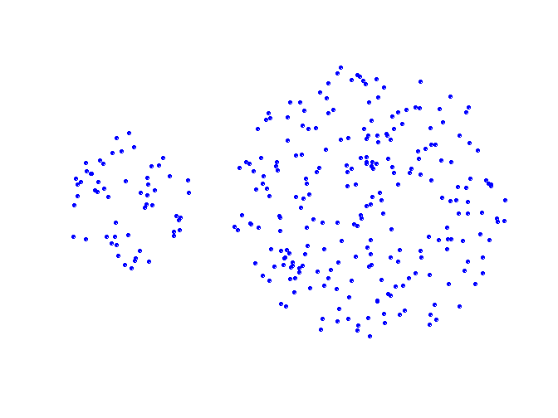
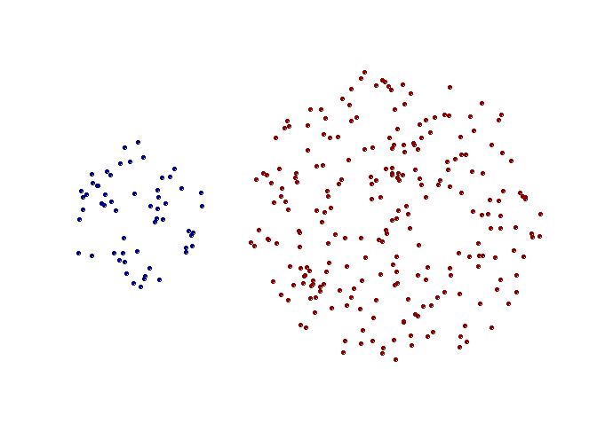
Strength of MIN
Original Points
Two Clusters
Can handle non-elliptical shapes

Slide 47
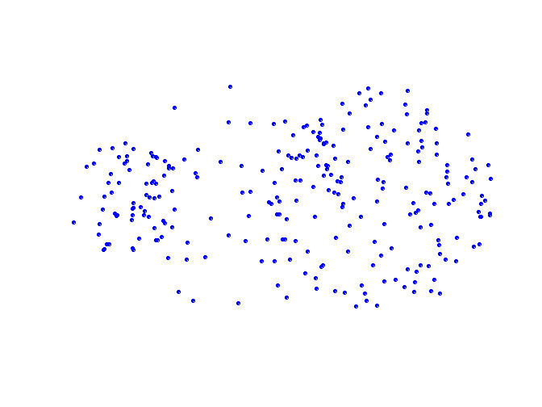
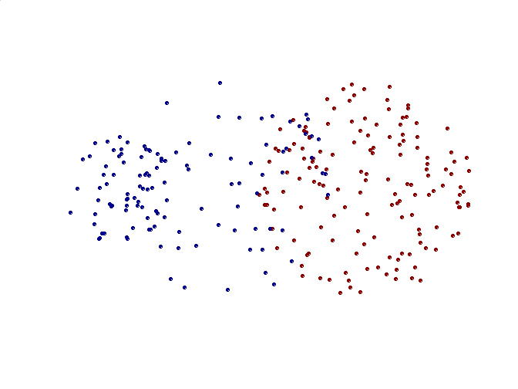
Limitations of MIN
Original Points
Two Clusters
Sensitive to noise and outliers

Slide 48
Cluster Similarity: MAX or Complete Linkage
Similarity of two clusters is based on the two least similar (most distant) points in the different clusters
Determined by all pairs of points in the two clusters
1
2
3
4
5

Slide 49
Hierarchical Clustering: MAX
4
1
2
5
5
2
3
6
3
1
4
Nested Clusters
Dendrogram

Slide 50
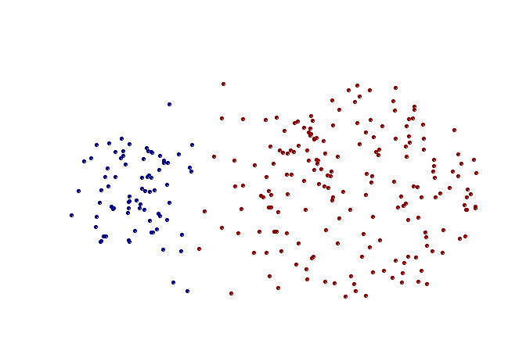
Strength of MAX
Original Points
Two Clusters
Less susceptible to noise and outliers

Slide 51
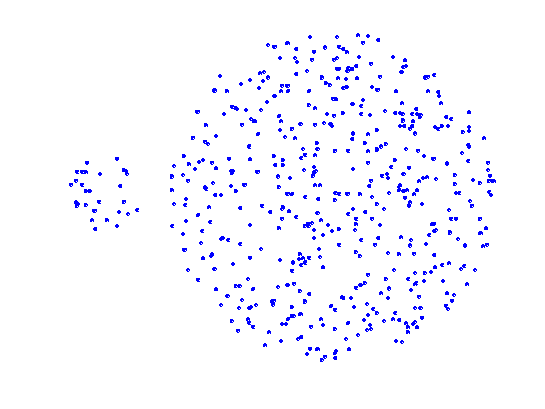
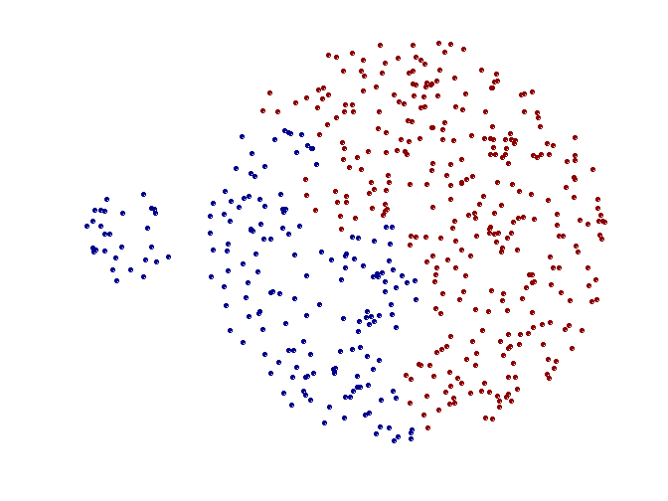
Limitations of MAX
Original Points
Two Clusters
Tends to break large clusters
Biased towards globular clusters

Slide 52
Cluster Similarity: Group Average
Proximity of two clusters is the average of pairwise proximity between points in the two clusters.
Need to use average connectivity for scalability since total proximity favors large clusters
1
2
3
4
5

Slide 53
Hierarchical Clustering: Group Average
5
4
1
2
5
2
3
6
1
4
3
Nested Clusters
Dendrogram

Slide 54
Hierarchical Clustering: Group Average
Compromise between Single and Complete Link
Strengths
Less susceptible to noise and outliers
Limitations
Biased towards globular clusters

Slide 55
Cluster Similarity: Ward’s Method
Similarity of two clusters is based on the increase in squared error when two clusters are merged
Similar to group average if distance between points is distance squared
Less susceptible to noise and outliers
Biased towards globular clusters
Hierarchical analogue of K-means
Can be used to initialize K-means

Slide 56
Hierarchical Clustering: Comparison
5
1
4
1
3
2
5
5
5
2
1
MIN
2
MAX
2
3
6
3
3
6
1
4
4
4
5
5
1
4
1
2
2
5
2
Ward’s Method
5
2
3
6
Group Average
3
3
6
4
1
1
4
4
3

